Slide 1
Spring Boot MVC

Slide 2
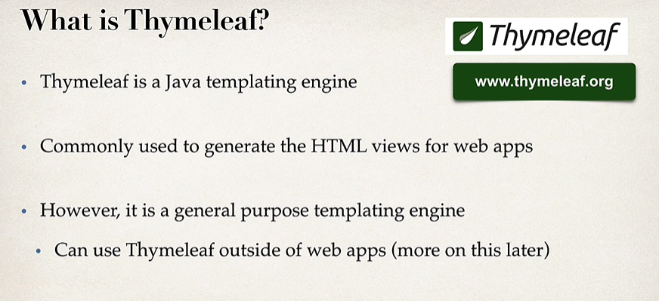
Thymeleaf

Slide 3
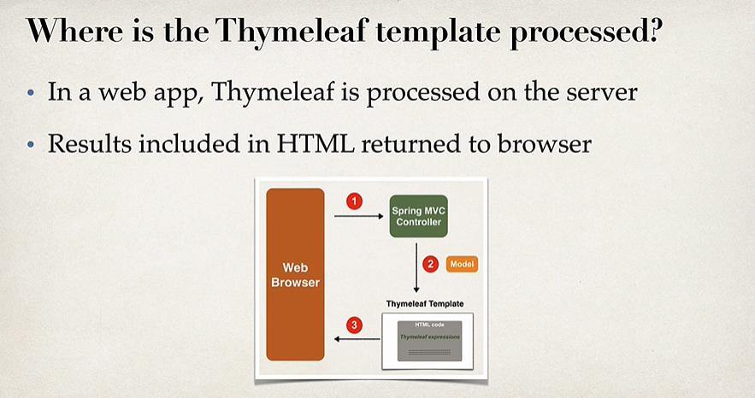
Thymeleaf
Spring boot Lookup order for static resources:
/META-INF/resources
/resources
/static
/public
Development Process
Add Thymeleaf to Maven POM…. <artifactId>spring.boot.starter.thymeleaf</artifactId>
Develop Spring MVC controller
Create Thymeleaf template (folder … src/main/resources/templates) (for web apps .html extension for thymeleaf templates)

Slide 4
Thymeleaf
<!DOCTYPE html>
<html xmlns:th=http://www.thymeleaf.org>
<head>
<title> Thymeleaf Demo</title>
<link rel="stylesheet" th:href="@{/css/demo.css}">
</head>
<body>
<form th:action="@{/processForm}" method="GET">
<input type="text" name="studentName" placeholder="What's is your name?" />
<input type="submit" />
</form>
<p th:text="'Time on the server is ' + ${theDate}" class="funny" />
Student Name : <span th:text="${param.studentName}" />
</body>
Calling Spring controller /processForm on submit
Accessing java string object in spring model
Accessing html form parameter

Slide 5
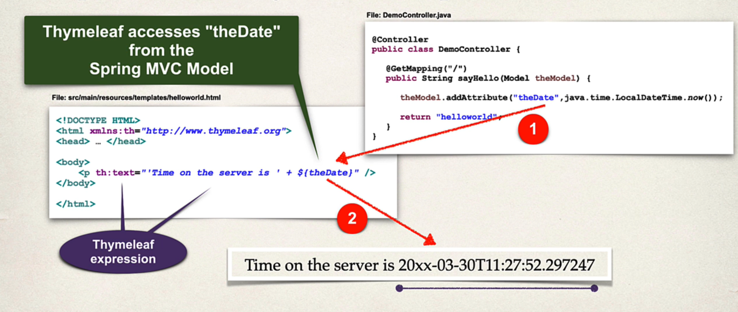
Thymeleaf

Slide 6
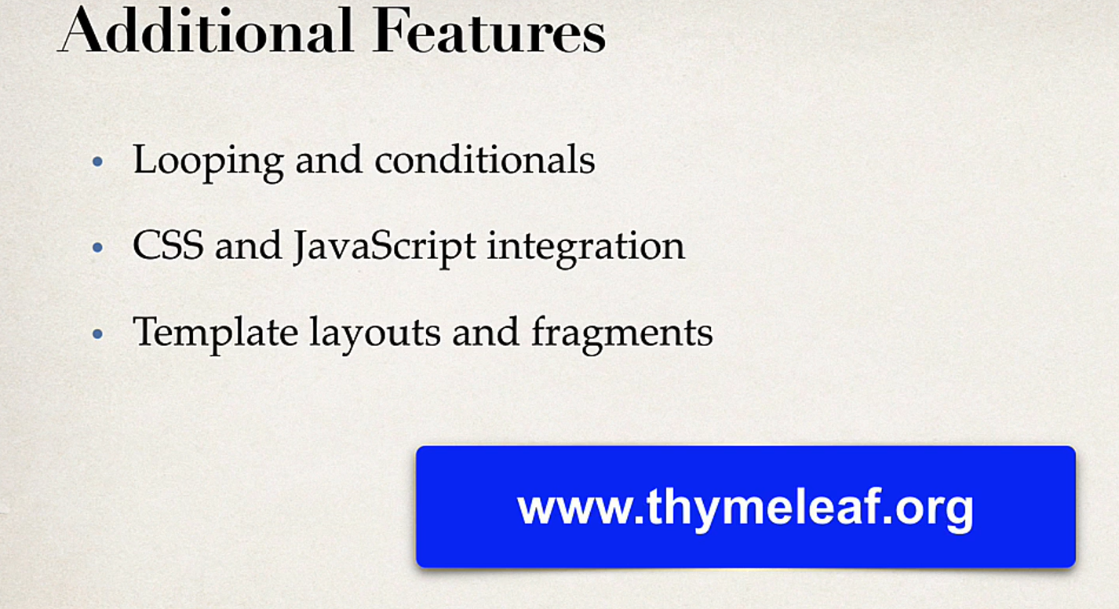
Thymeleaf – additional features

Slide 7
Controller
Calling Spring controller /processForm on submit
@RequestMapping("/showForm")
public String showForm() { return "helloWorld-Form"; }
@RequestMapping("/processForm")
public String processForm() { return "helloWorldOutput"; }
@RequestMapping("/processFormV2")
public String processFormV2 (HttpServletRequest request, Model model){
//Read request param from html form
String theName = request.getParameter("studentName");
//convert data to all uppercase
theName = theName.toUpperCase();
//create message
String result = "Helloooo ! " + theName;
//add message to model
model.addAttribute("message", result);
return "helloWorldOutputV2";
}
@RequestMapping("/processFormV3")
public String processFormV2(@RequestParam("studentName") String theName, Model model){
//convert data to all uppercase
theName = theName.toUpperCase();
//create message
String result = "Helloooo ! " + theName;
//add message to model
model.addAttribute("message", result);
return "helloWorldOutputV3";
}

Slide 8
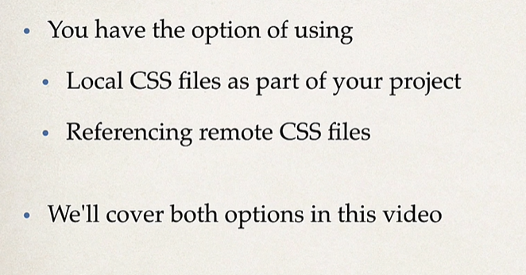
Using CSS with Thymeleaf templates

Slide 9
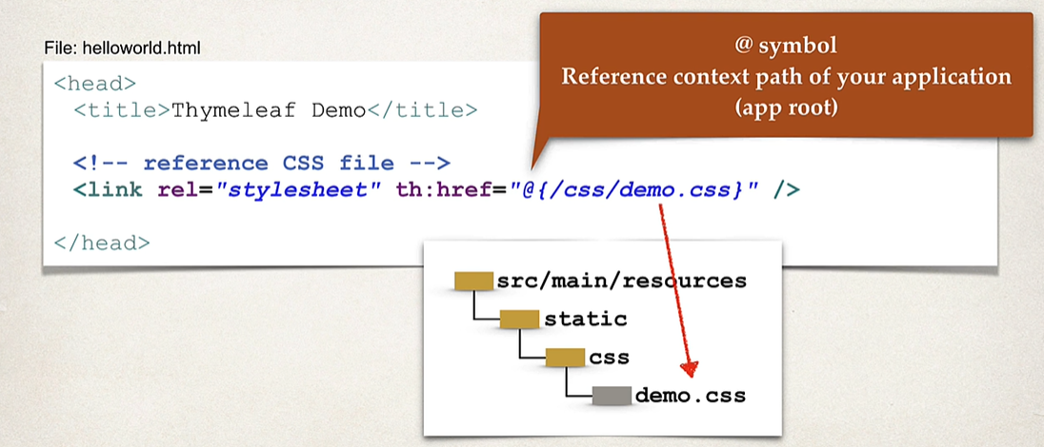
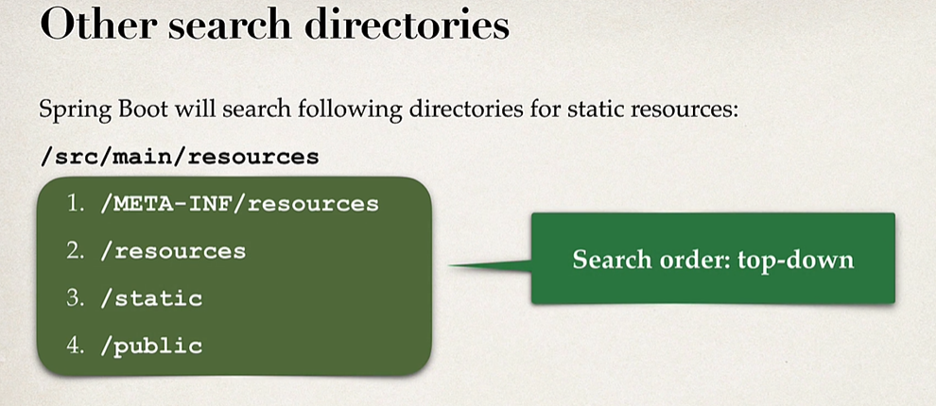
Using CSS with Thymeleaf templates
Spring Boot will look for static resources in the src/main/resources/static directory. So create a CSS file and place it over there. You could create folder under static directory – like src/main/resources/static/css/*.css files

Slide 10
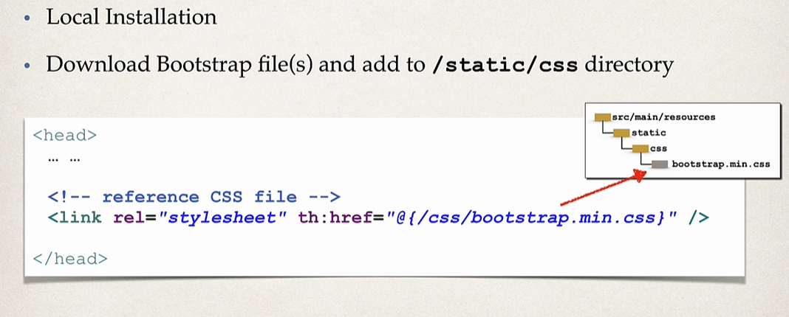
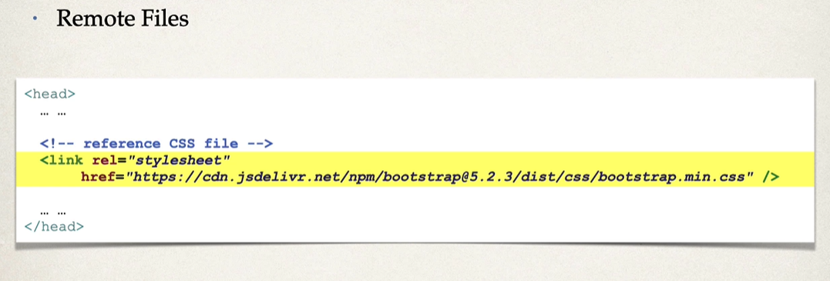
3rd Party CSS Libraries - Bootstrap

Slide 11
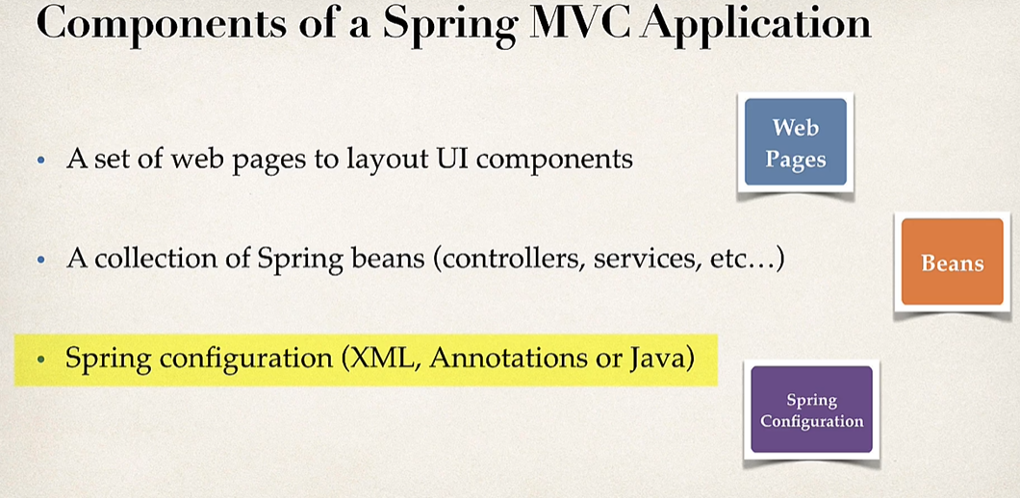
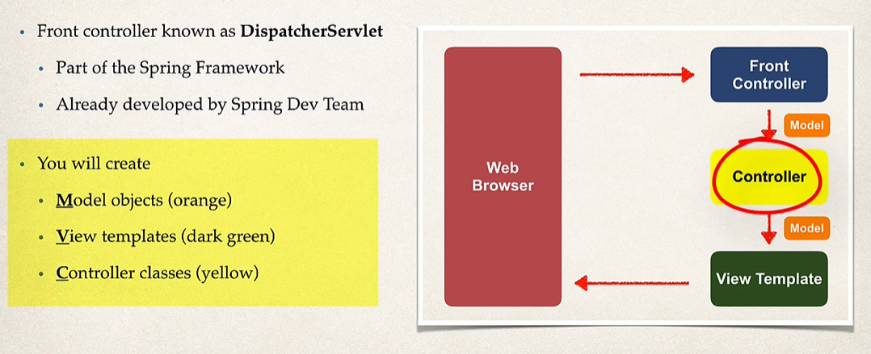
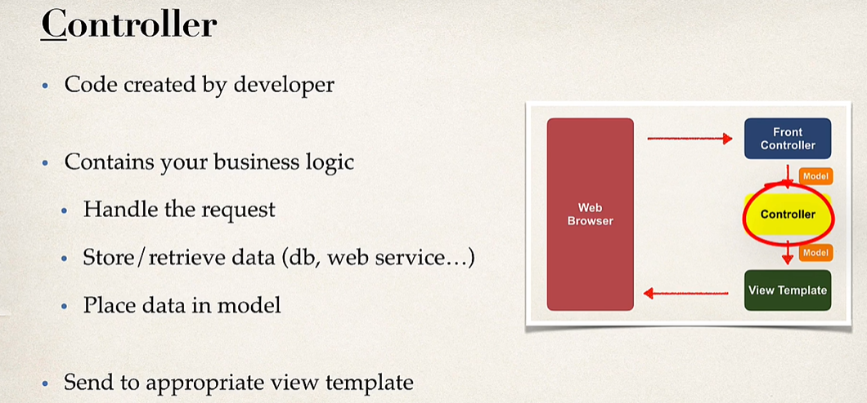
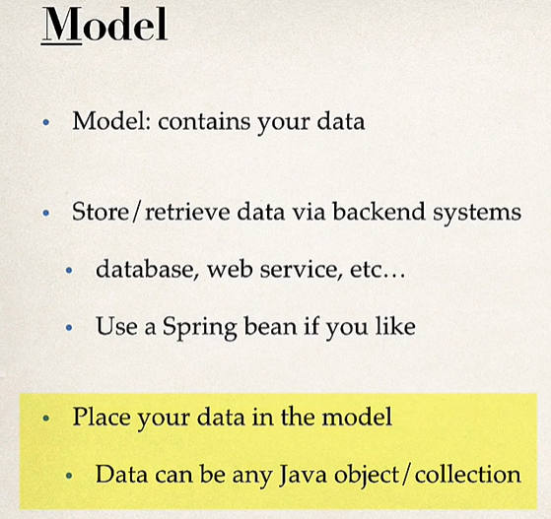
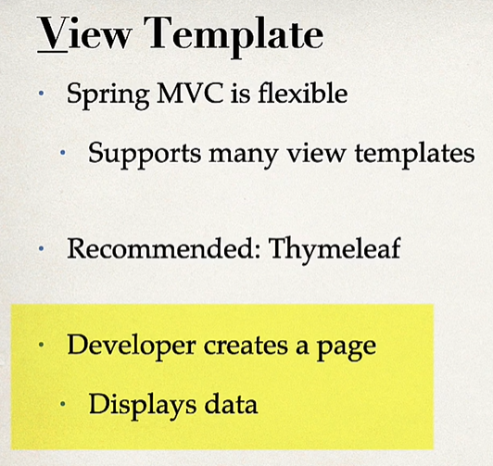
Spring MVC – Behind the scenes
Data
Business logic

Slide 12
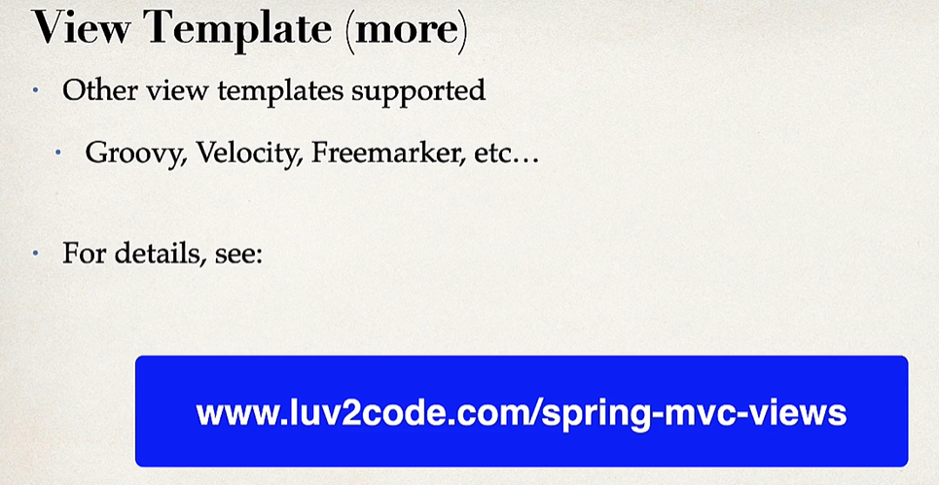
Spring MVC – Behind the scenes

Slide 13
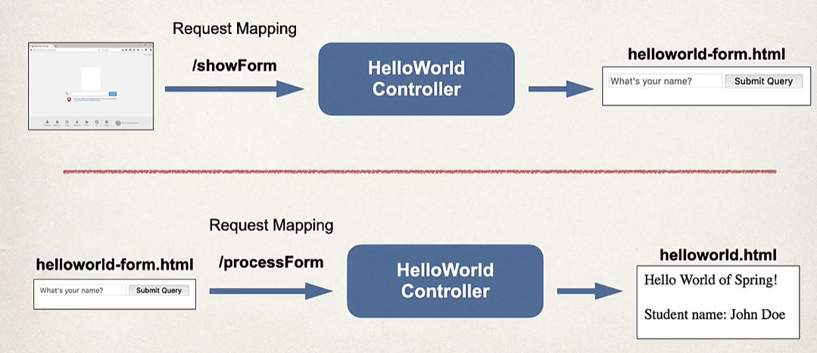
Reading Data from HTML form – App flow

Slide 14
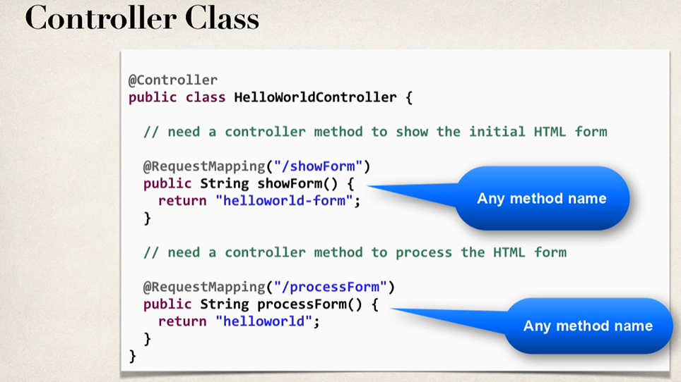
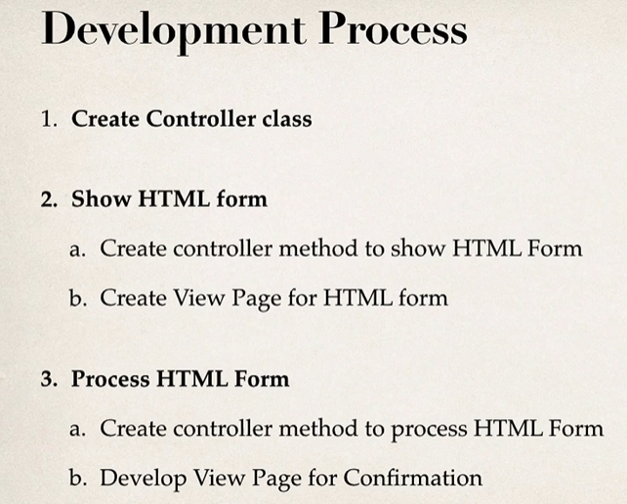
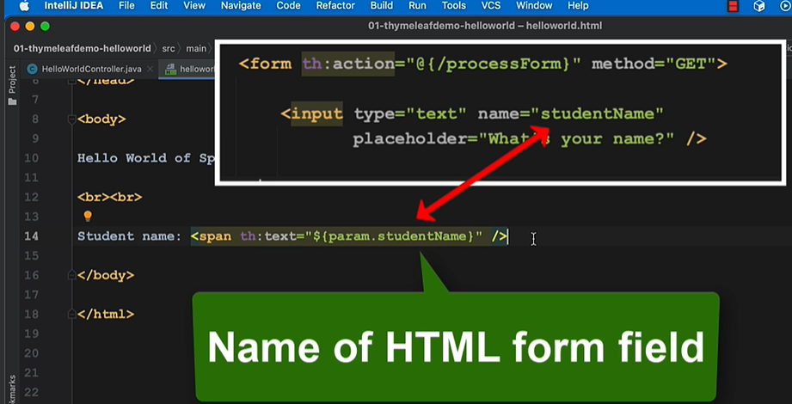
Reading Data from HTML form – Controller class

Slide 15
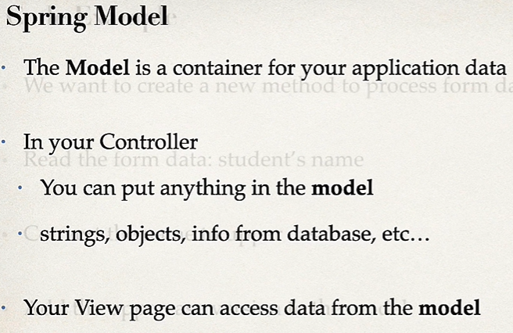
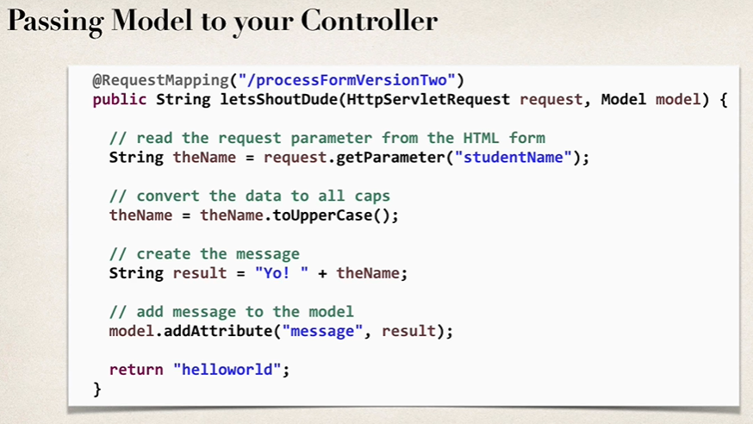
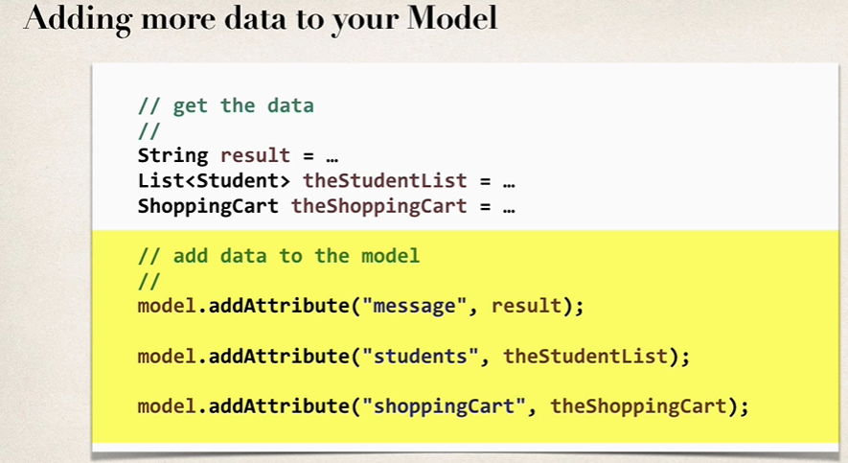
Adding data to Spring MVC model

Slide 16
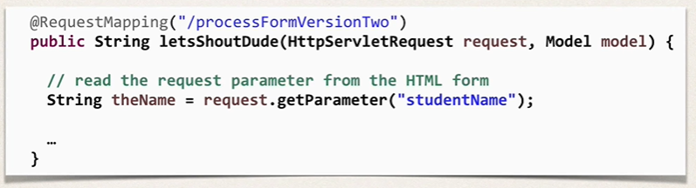
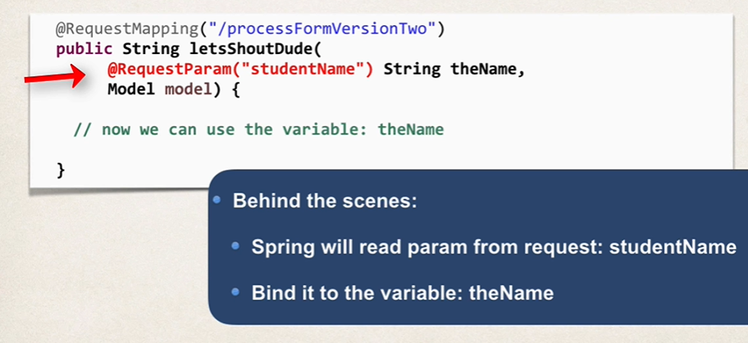
Spring MVC Binding – Request Parameter
Reading param from HttpServletRequest
Using @RequestParam annotation to read param data

Slide 17
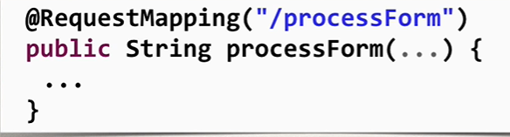
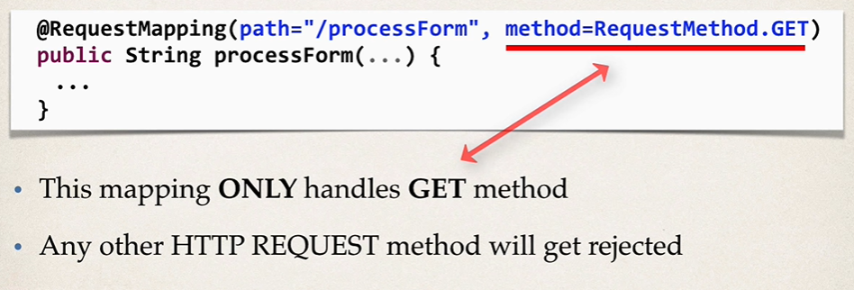
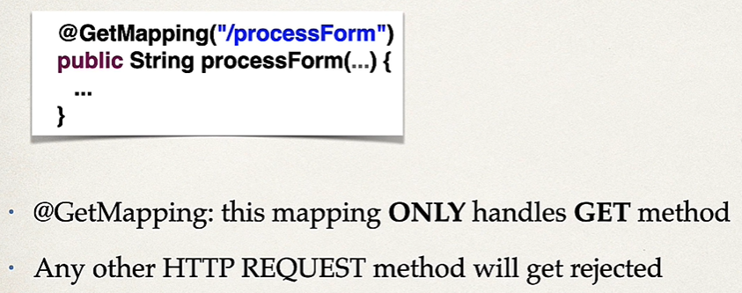
Spring Boot – GetMapping and PostMapping
Following handles all HTTP methods; GET, POST, etc
Constrain the request mapping - GET
Annotation Shortcut - GET

Slide 18
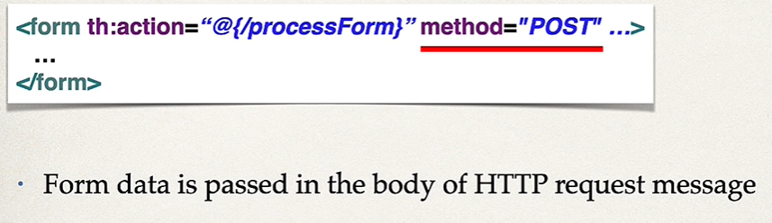
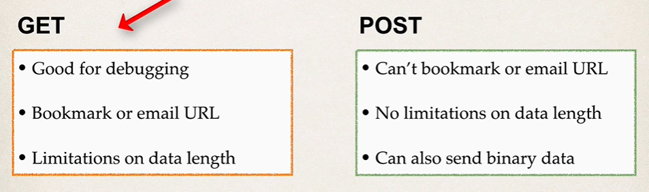
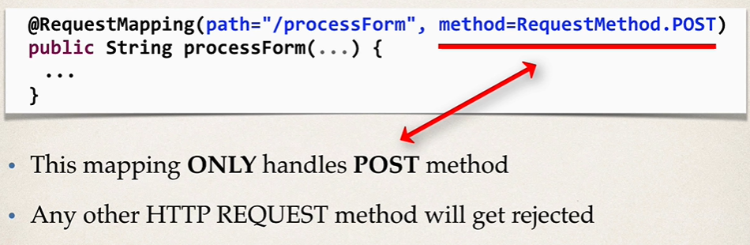
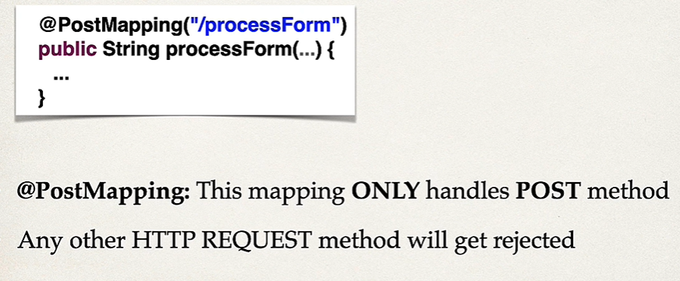
Spring Boot – GetMapping and PostMapping
Sending form data using POST
Which one is good? GET or POST
Constrain request mapping - POST
Annotation Shortcut - POST

Slide 19
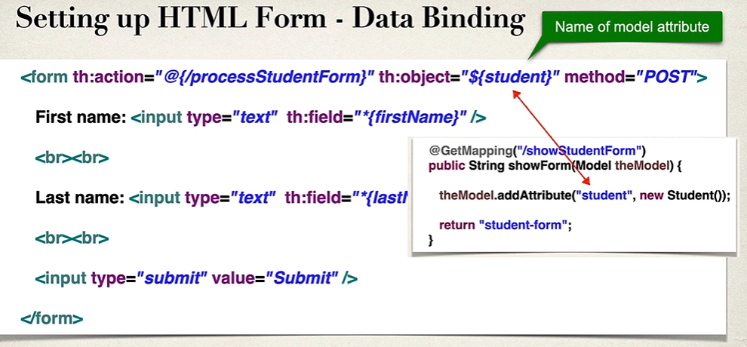
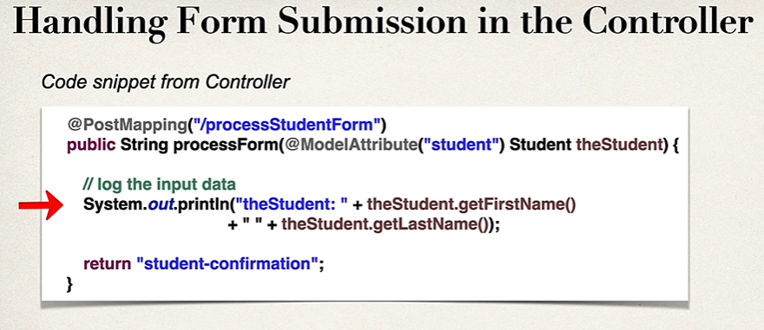
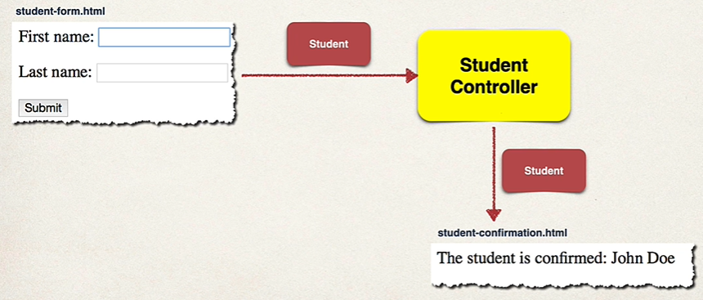
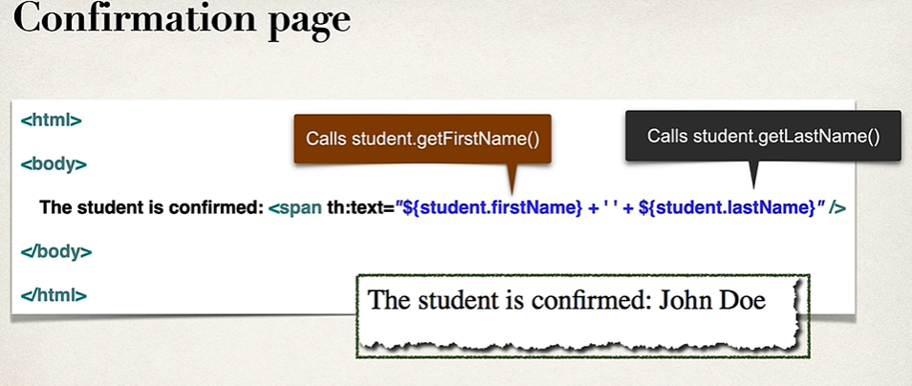
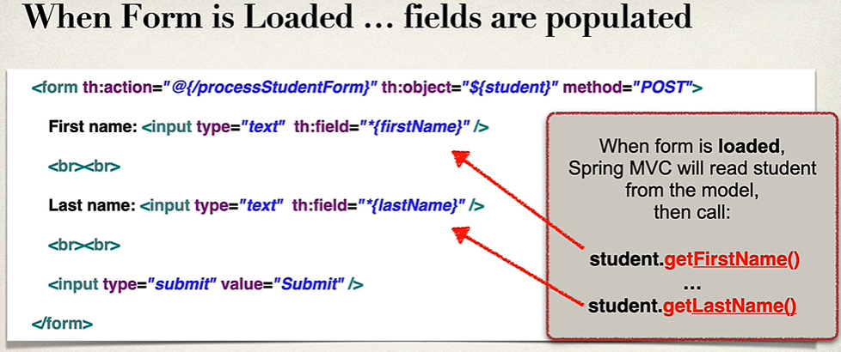
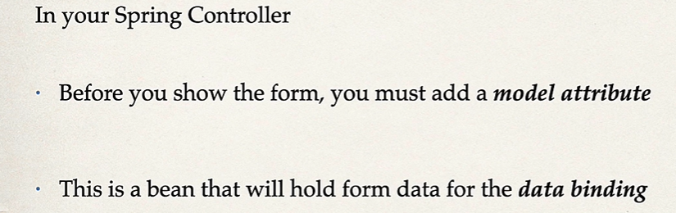
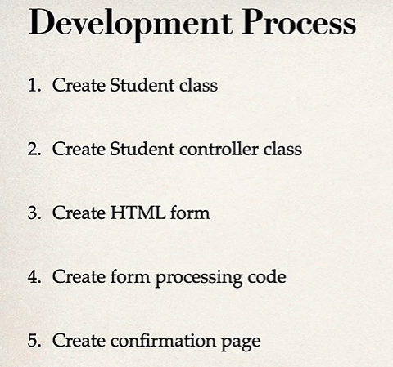
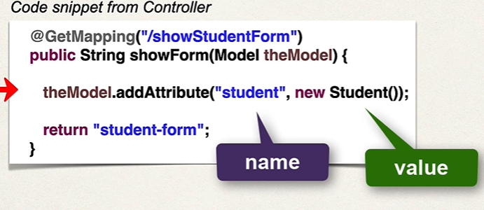
Spring MVC – FORM data binding – Text Field
HTML Form Data binding:
- Automatically setting and retrieving data from a Java object / Bean
Instead of reading data from Http Request, read it from Java object / bean
*{firstName} = ${student.firstName}
When the form is submitted, Spring MVC will create a new student instance and call setter methods – setFirstName(…) and setLastName(…)

Slide 20
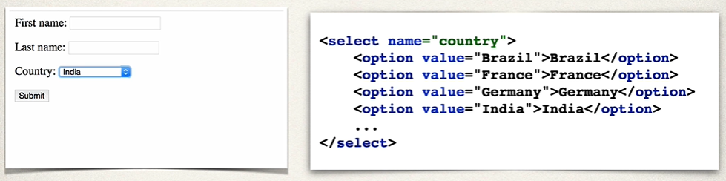
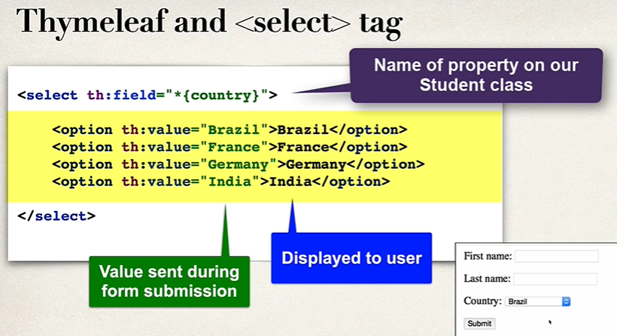
Spring MVC – FORM– Dropdown

Slide 21
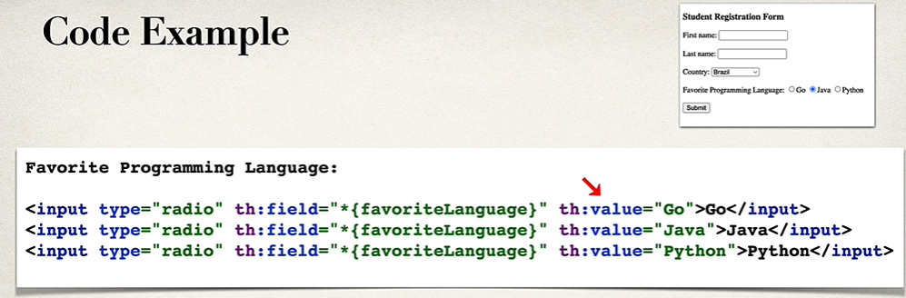
Spring MVC – FORM– Radio button

Slide 22
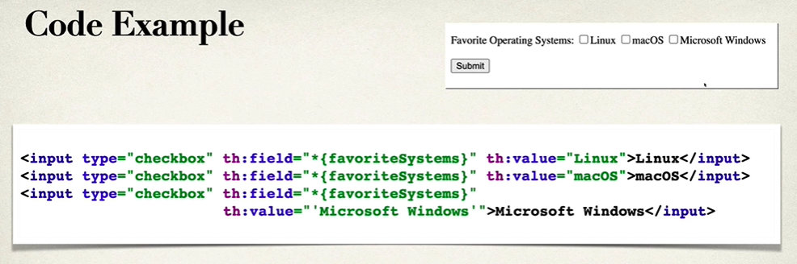
Spring MVC – FORM– Checkbox
If a value has spaces, place it in single quote

Slide 23
Spring MVC – FORM– Validation

Slide 24
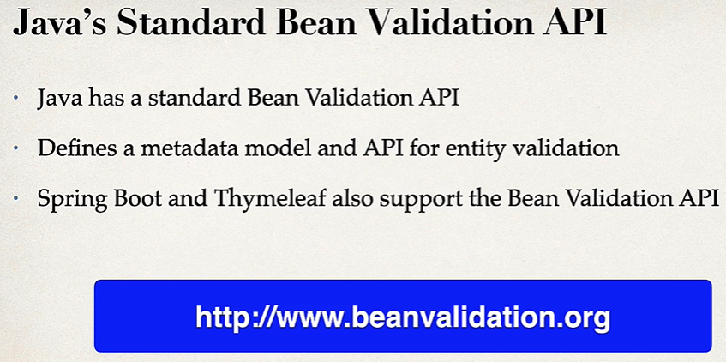
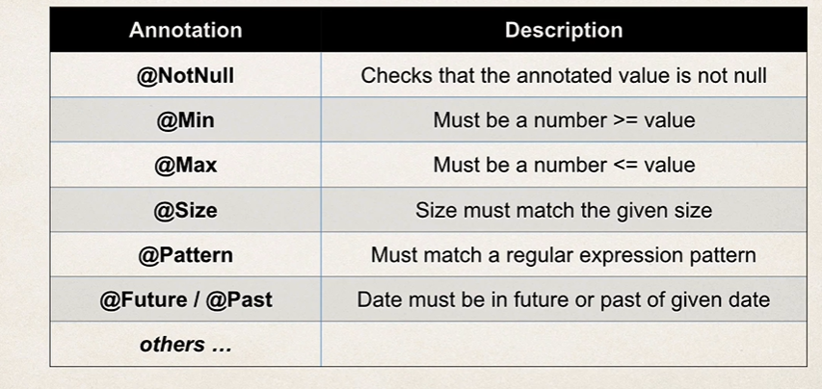
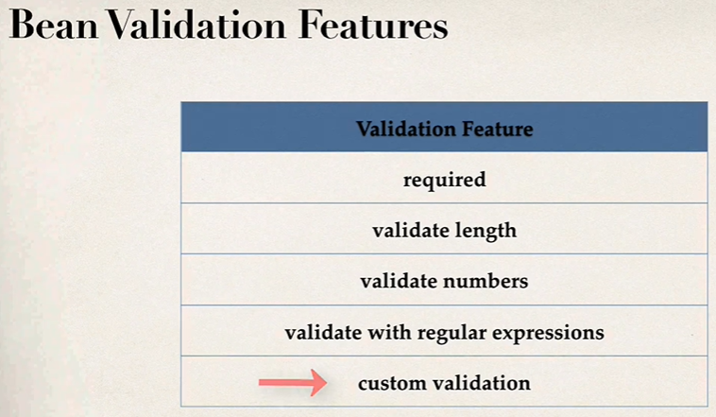
Spring MVC FORM – Validation
Maven Dependencies: Spring web, Thymeleaf, Validation, Dev tools

Slide 25
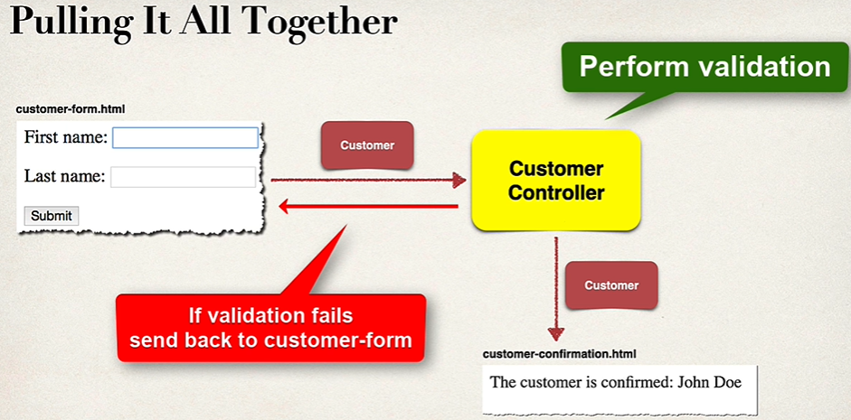
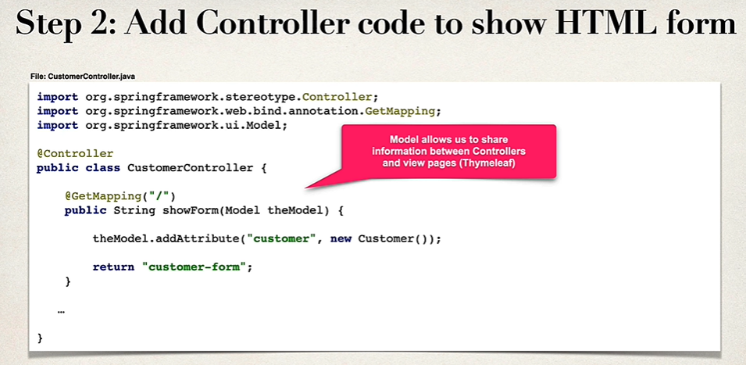
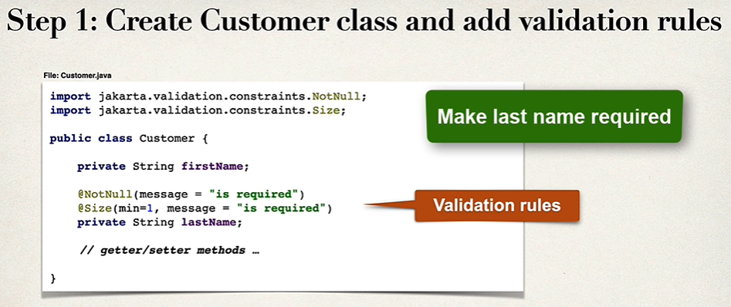
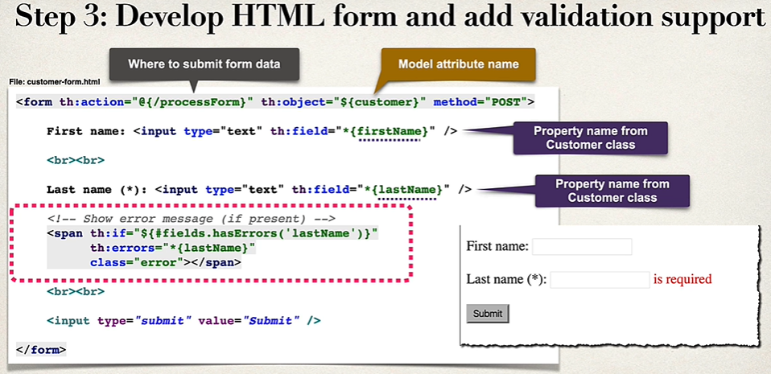
Spring MVC FORM – Validation – Required fields
Maven Dependencies: Spring web, Thymeleaf, Validation, Dev tools

Slide 26


Spring MVC FORM – Validation – Required fields
Maven Dependencies: Spring web, Thymeleaf, Validation, Dev tools

Slide 27




Spring MVC FORM – Validation – InitBinder
Usage
For all string parameters, apply the custom editor

Slide 28


Spring MVC FORM – Validation – Numbers
Step 2, 3 and 4 are very similar to text field validation.

Slide 29

Spring MVC FORM – Validation – RegEx

Slide 30

Spring MVC FORM – Integer field required - validation
Use Integer type instead of primitive variable int.

Slide 31



Spring MVC FORM – custom messages
To get these error codes on the console, use BindingErrorsObject.toString(). Refer the slide “Required Fields validation” for bindingErrors object

Slide 32






Spring MVC FORM – custom validation
Field Type to be validated
Annotation

Slide 33
End

